Slide 1
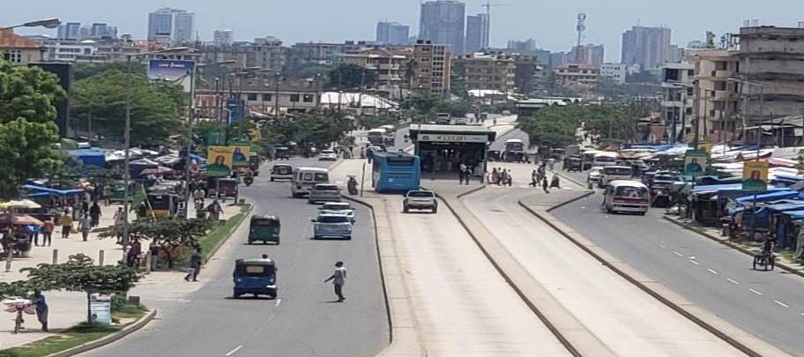
IUC Project Urban transport: Safe, inclusive and sustainable urban transport system
Local team leader:Dr. Wilfred Kazaura & Eng Dr. Frank Wambura– SSPSS, Ardhi University
Flemish team leader: Prof. An Neven – UHasselt

Slide 2
Project Objective
To build capacity in academic, societal outreach, research, and innovation on urban transport, in order to achieve a safe, inclusive and sustainable urban transport system
Academic: enhance local and international academic collaborations:
Development of a double degree programme Urban Transportation, as joint agreement in collaboration with UHasselt
Development of double degree PhD’s in TS and Urban Logistics
Societal outreach: dissemination of results, addressing the needs of relevant stakeholders in the transport sector – via interaction/ collaboration
Research: creation of ‘platform on transport, logistics and traffic safety’ based on participation of international and local key stakeholders.

Slide 3
Urban transport challenges
Dar esSalaam City is facing a significant transportation challenges due to rapid urbanization
Major challenges include:
Traffic unsafety (children & women being most affected)
Lack of infrastructure, dangerous traffic conditions, driver behaviour, etc.
Increasing number of road accidents
Traffic congestion
Insufficient transport systems, unorganized public transport (except BRT)
Increasing traffic volumes & rising motorization
Non-motorized transport systems
Unavailable and unsafe -> limits walkability and cycling
Green transport
Tree planting, protection and conservation of road corridors
Multi-modes connectivity
Limited access to alternative modes of transport to Terminals and stations
Urban logistics and traffic management
Unmanaged freight traffic & overloading
Informal activities along the road corridol and proximity of DAR port, etc.

Slide 4
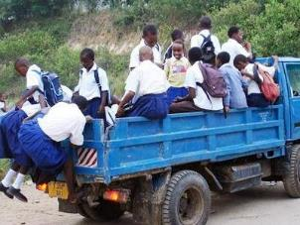
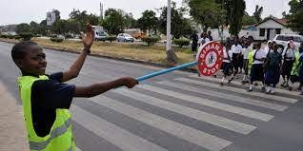
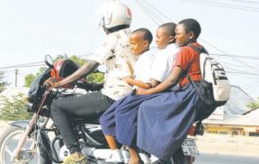
Issues identified for phase 1
1. Unsafe traffic to city dwellers: including school children, pedestrian, cyclists, carts.
Volunteers: help people to cross the road
Risk of accident when travelling to school

Slide 5
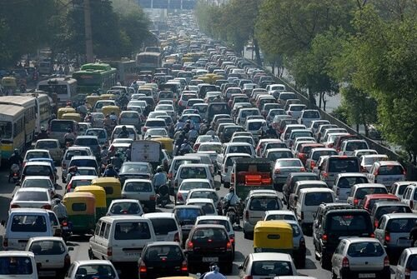
2. Congestion management in the city
Traffic jams during peak hours
Increase of fuel consumptions
Increase of travel times
Lost of working time

Slide 6
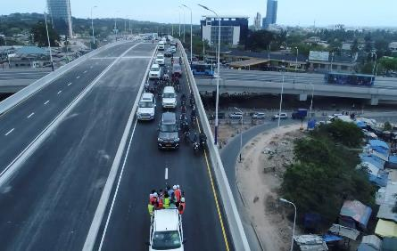
3. Under provision of pedestrian walkways: including cyclists, carts.
Unsafe access to and
from BRT stations
BRT
Under provision of pedestrian, cyclist and carts on urban infrastructure projects

Slide 7
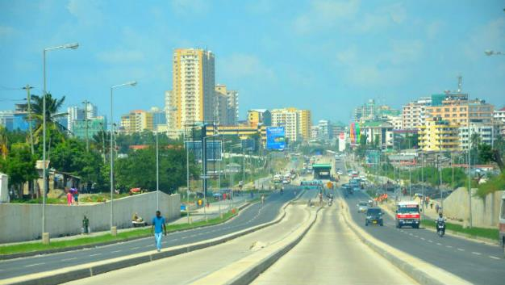
4. Green transport and alternative energy: Control of carbon emissions and encouraging walking and cycling
Dar green corridors
Retaining walls
Infrastructure developments does
not include green development concept (GDC)
Use of biofuels to reduce carbon emission.

Slide 8
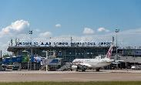
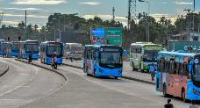
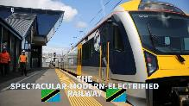
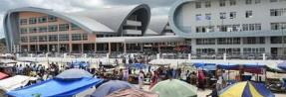
5. Lack of intermodal connectivity: Lack of alternative modes of transport connected to main Bus Terminals at Mbezi, JNIA-Airport, Central Railway station and BRT network.
Terminals and stations have limited access to other modes of transport systems
BRT network
Central station
Bus Terminal

Slide 9
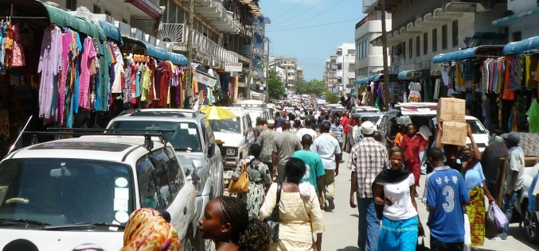
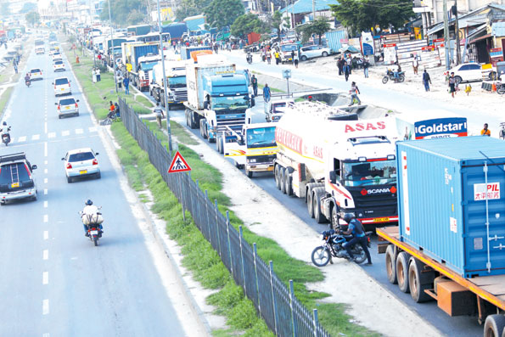
6. Management of transport systems
Business along roadways
Access is very much limited
Heavy tracks and small vehicle in a single lane
One direction traffic during Peak hours

Slide 10
Study locations
Items | Location of the study
1. Highways and walkways | Highway’s intersections with fly-overs: Ubungo Signalized intersection: Fire-Kariakoo Non-signalized intersection at Kigogo round about Non-motorized traffic (pedestrian, cyclists, carts): Kariakoo, Mwenge, Uhuru road. Signals and signs along Morocco-Mwenge road.
2. Terminals & Stations | Mbeki Bus Terminals JNIA-Airport terminals Railway terminal at central station Kariakoo BRT station
3. Bio-fuel station | Bio-fuel stations (Bagamoyo)

Slide 11
Our Team
Local team members-ARU
Dr. Wilfred Kazaura – (Local team leader)
Dr. Frank Wambura (Ass. team leader)
Dr. Geophrey Joseph-Member
Eng. Catherine Awidi-Otyek Mushi-Member
Eng. Ernest Baraganba-Member
Local Collaborations
Dr Prosper Nyaki- National Instutute of Transport (NIT)
Prof Hannibal Bwire-CoET, University of Dar es Salaam
Dr.Lucy Joseph Chabariko- Department of Geography; University of Dar es Salaam
Dr. Jairos Kahuru Shinzeh–Department of Mathematics and Statistics
University of Dodoma

Slide 12
Key stakeholders
Eng. Dr. Fikiri Fredrick Magafu & Eng Almas Arif Mohamed
MINISTRY OF LOCAL GOVERNMENT AND REGIONAL ADMINISTRATION;
2. Mr. Gilliard W. Ngewe- LAND TRANSPORT REGULATORY AUTHORITY;
3. Mr. Gastor Nicephory Kikuji & Mr Amos Chikongoye
TANZANIA RURAL AND URBAN ROAD AGENCY (TARURA);
4. Aunyisa Boniface Meena- MINISTRY OF WORKS TRANSPORT AND COMMUNICATION;
5. Delfina Mathias Pweleza, - DAR ES SALAAM RAPID TRANSIT AGENCY,
6. Mr Simon Kokolo – AMEND
7. Eng. Musa George - TANZANIA NATIONAL ROADS AGENCY (TANROADS)

Slide 13
Flemish team members-Beljium
Prof. dr. An Neven – IMOB, UHasselt (team leader)
Transport organisation, travel behaviour, road safety, public transport, GIS
Prof. dr. Davy Janssens – IMOB, UHasselt
Travel behaviour, traffic safety, transportation systems
Team member (to be specified later) about traffic safety will be added
Prof. dr. Wouter Dewulf – UAntwerp
Urban logistics, transport management, supply chain management
Prof. dr. An Caris – Logistics, UHasselt
Urban logistics, synchromodal transport
Prof. dr. Kris Braekers – Logistics, UHasselt
Urban logistics, vehicle routing
Busworld Academy
Public transport, knowledge sharing
Team will be further reformed, based on specified research topics

